Slide 1
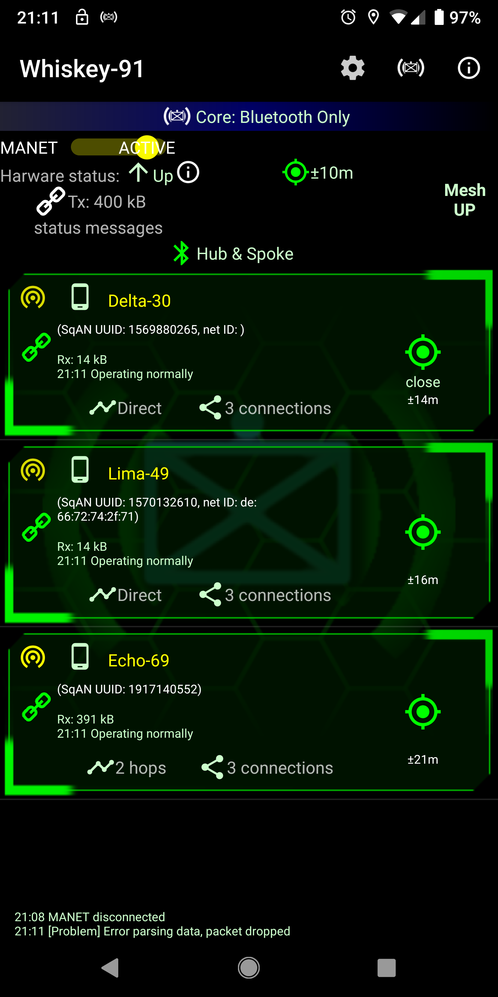
1. Switch to “Bluetooth Only” method (the app should recommend this automatically)
2. Form your team (see next page)
Basic network performance stats are available here.
SqAN is only considered “UP” when this device is receiving information from every teammate.
This device is acting as both a Hub for some devices and a Spoke to other devices. This changes over time.
Relative distance to Delta-30 (“close” means the two devices are within their cumulative uncertainty)
Data from Echo-69 is taking 2 hops to get to this device (i.e. data is being relayed by two devices in the middle). Network reconfigures to try to minimize hops so this number drops as the mesh finds more efficient routes.
Echo-69 is exchanging data with 3 other devices.

Slide 2
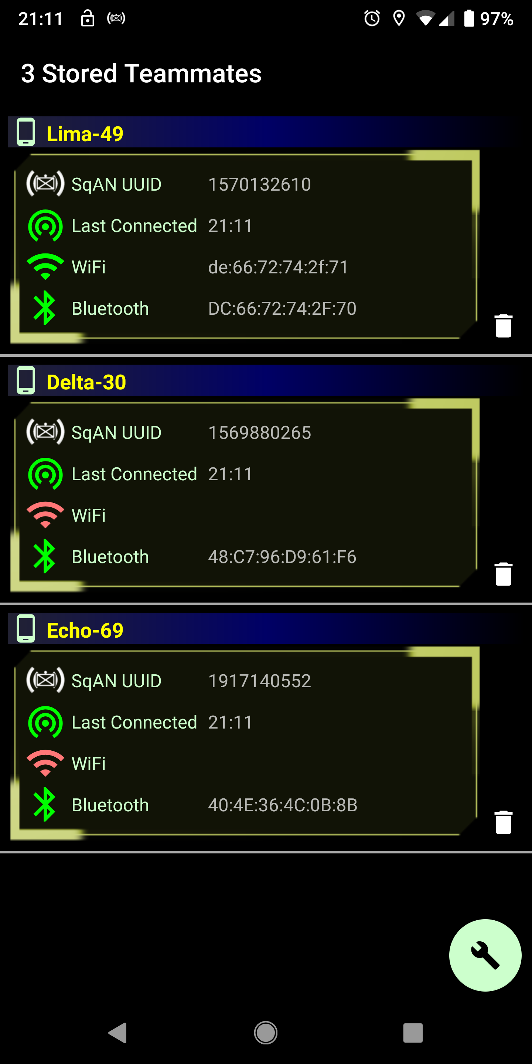
SqAN has enough information and permission to connect to Lima-49 via WiFi, but not Delta-30
SqAN will continually try to connect to every teammate listed. If you no longer want to connect to a device, click on the trash can.
3. The “Fix” button tries to make any changes needed to connect to teammates. Discovery of teammates is automatic, but some things (like Bluetooth) need a one-time approval for pairing. All other devices show-up as “sqan######” with their UUID when pairing (this is changed automatically on each device).

